Slide 1


Slide 2


ROBOTIC PROCESS AUTOMATION
TESTLINK MIGRATION VALIDATION
RUKKSANA A - PJT929
Copyright 2023, Ramco Systems Limited. Information subject to change. All rights acknowledged.

Slide 3


VISION
In this project, the objective is to automate the extraction of data from Jira and Testlink and verify the test-related information such as Test Suites, Test Cases and make sure that there is no data loss across during the migration.
Copyright 2023, Ramco Systems Limited. Information subject to change. All rights acknowledged.

Slide 4
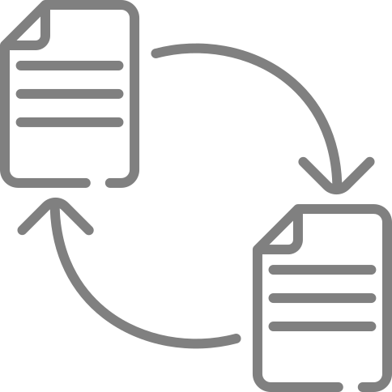
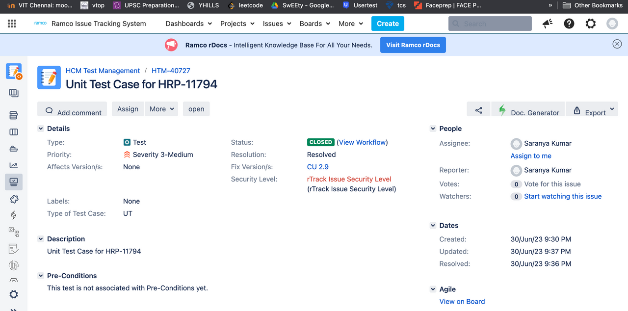
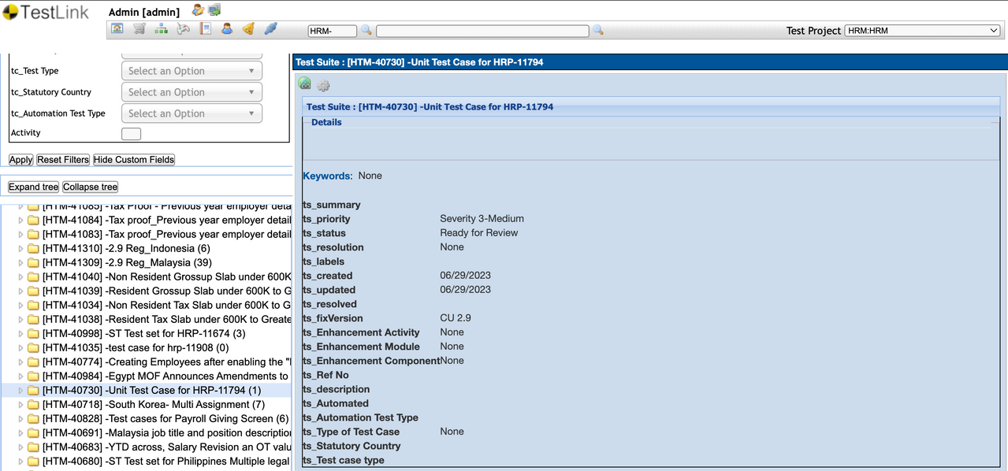
OBJECTIVE
To perform a thorough comparison between the original data in Jira and the data imported into TestLink. This validation step will ensure that the data transfer has been successful and all the attributes are matched
Copyright 2023, Ramco Systems Limited. Information subject to change. All rights acknowledged.

Slide 5

CHALLENGES
1
Large data files
2
Duplication and mismatched File names
3
Only Testsuite and Test Cases can be exported from the TestLink
LEARNINGS
Python Libraries
File Handling - XML
File Handling - JSON
RegEx
Copyright 2023, Ramco Systems Limited. Information subject to change. All rights acknowledged.

Slide 6




Comparing TestLink XML file with Jira XML file
THE PROCESS
Comparing TestLink XML with Jira JSON file - Test Suite
Comparing TestLink TestLink XML with Jira JSON file - Test Case
Copyright 2023, Ramco Systems Limited. Information subject to change. All rights acknowledged.

Slide 7
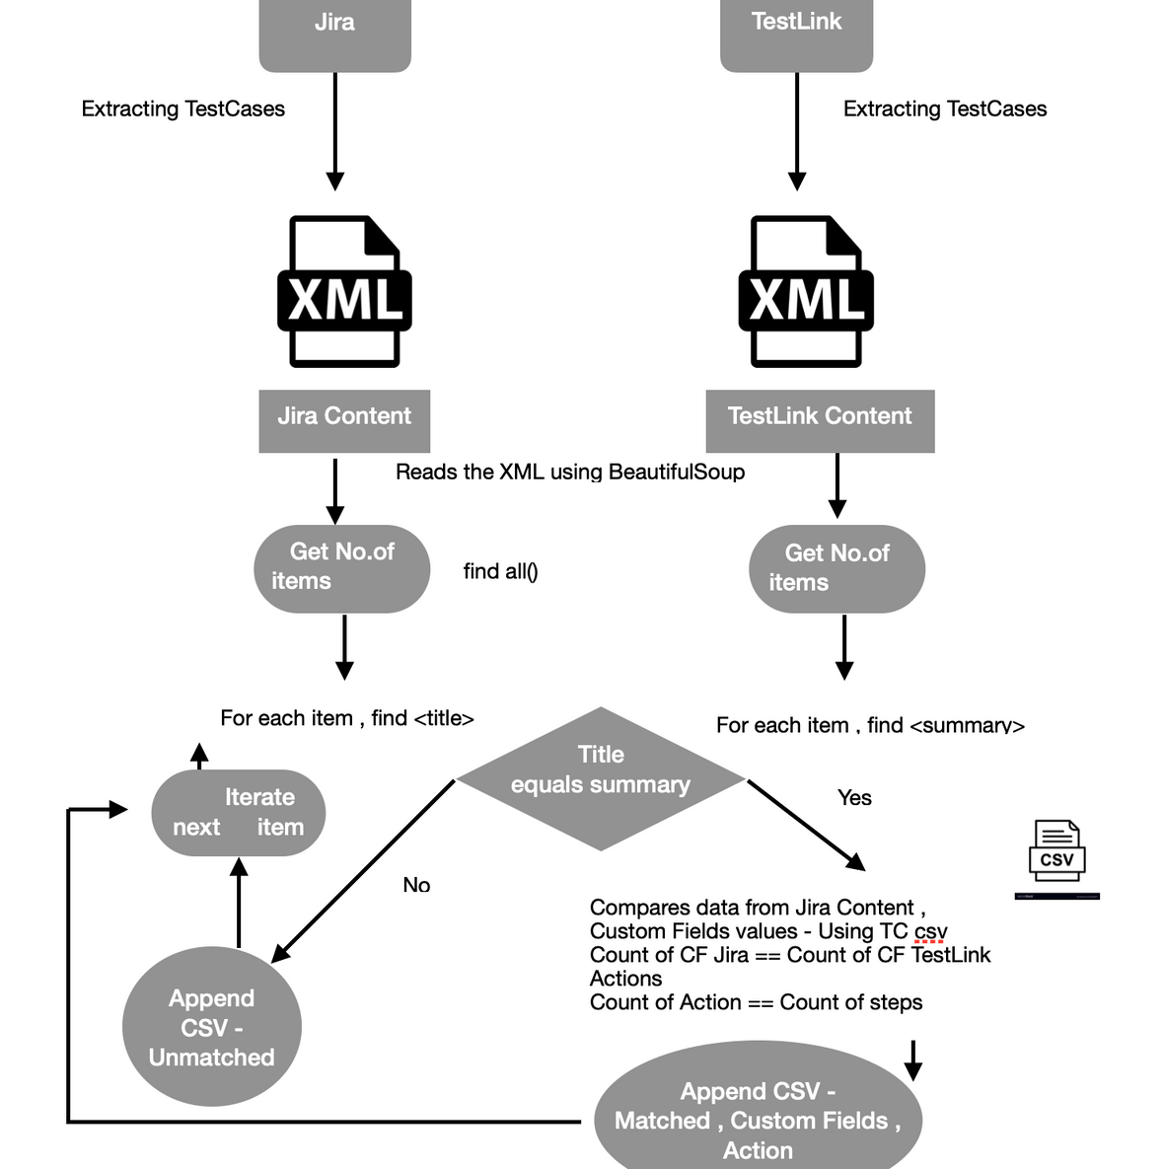
PROCESS OF
VALIDATION BETWEEN
JIRA - XML FILE & TESTLINK - XML FILE
Copyright 2023, Ramco Systems Limited. Information subject to change. All rights acknowledged.

Slide 8
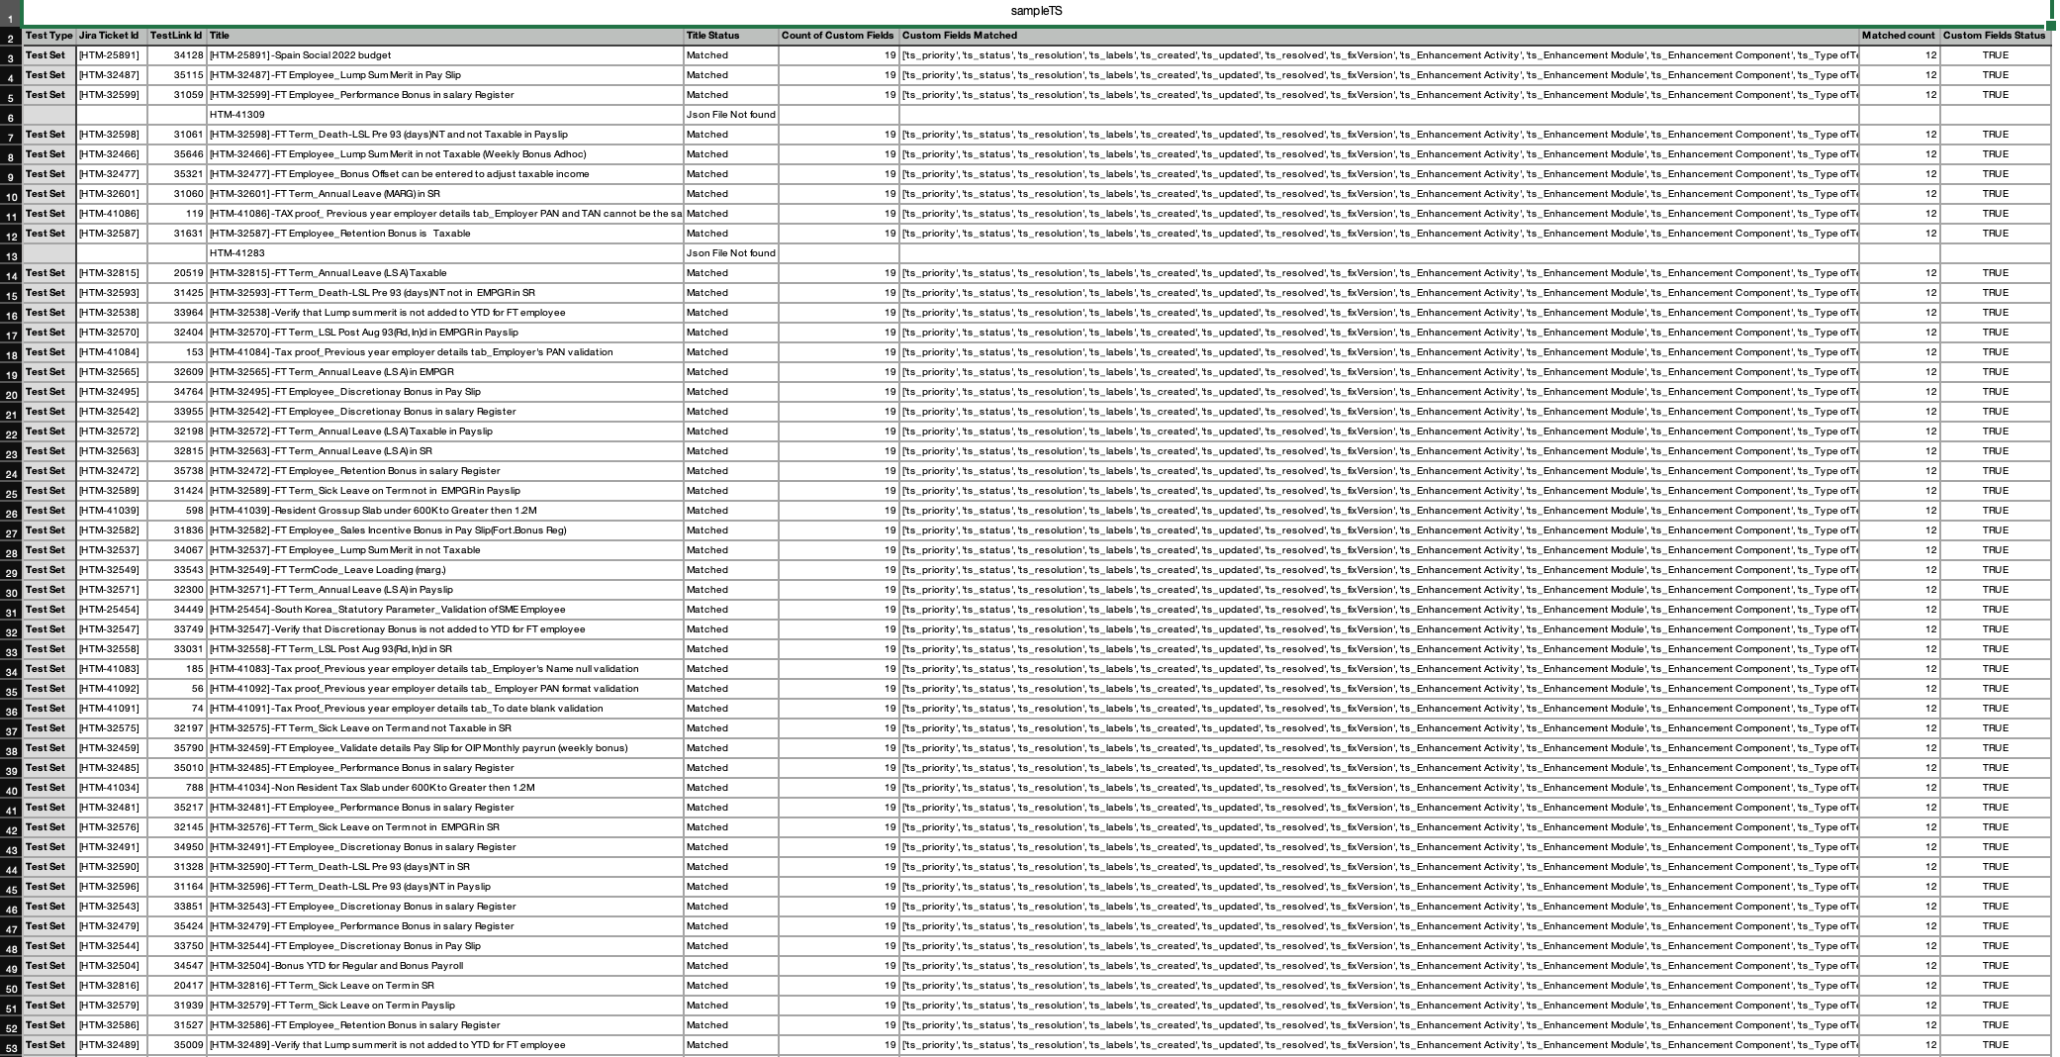

OUTCOME
SAMPLE
MATCHED STATUS - TESTLINK TICKET , JIRA TICKET , TITLE , CUSTOM FIELDS , ACTIONS

Slide 9
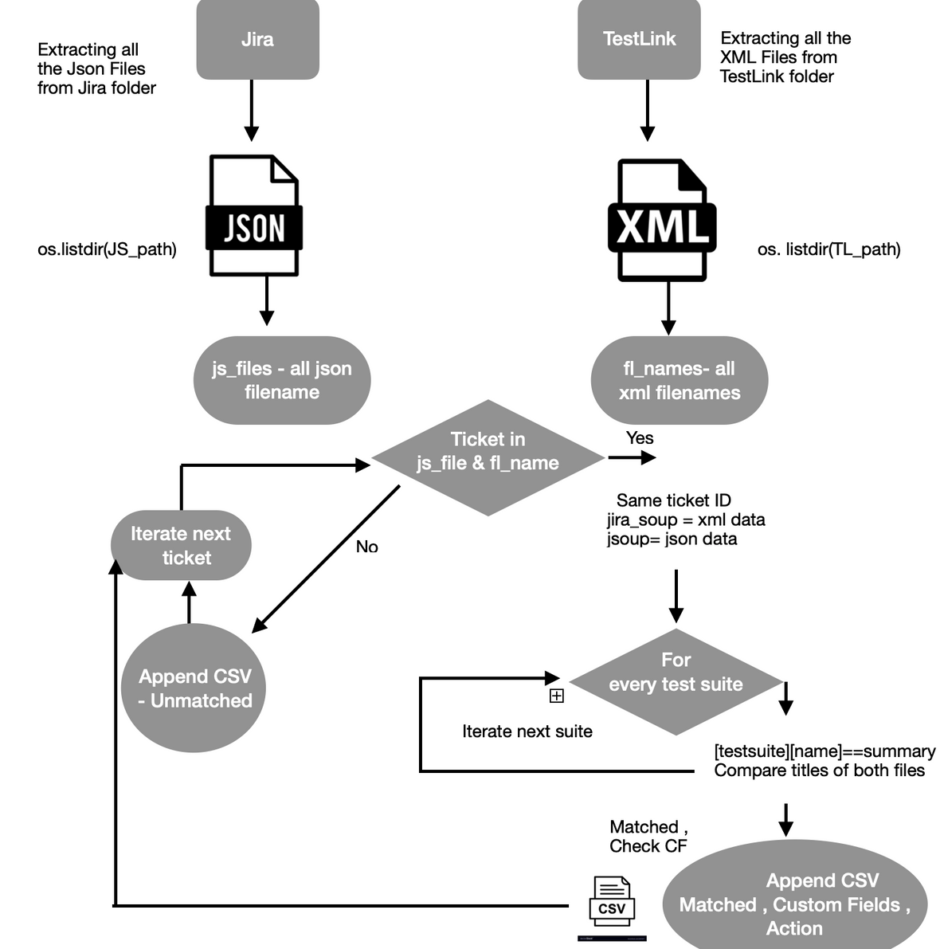
PROCESS OF
VALIDATION BETWEEN
JIRA - JSON FILE & TESTLINK - XML FILE
FOR TESTSUITE
Copyright 2023, Ramco Systems Limited. Information subject to change. All rights acknowledged.

Slide 10
OUTCOME SAMPLE
MATCHED STATUS - TESTLINK ID , JIRA TICKET , TITLE , CUSTOM FIELDS

Slide 11
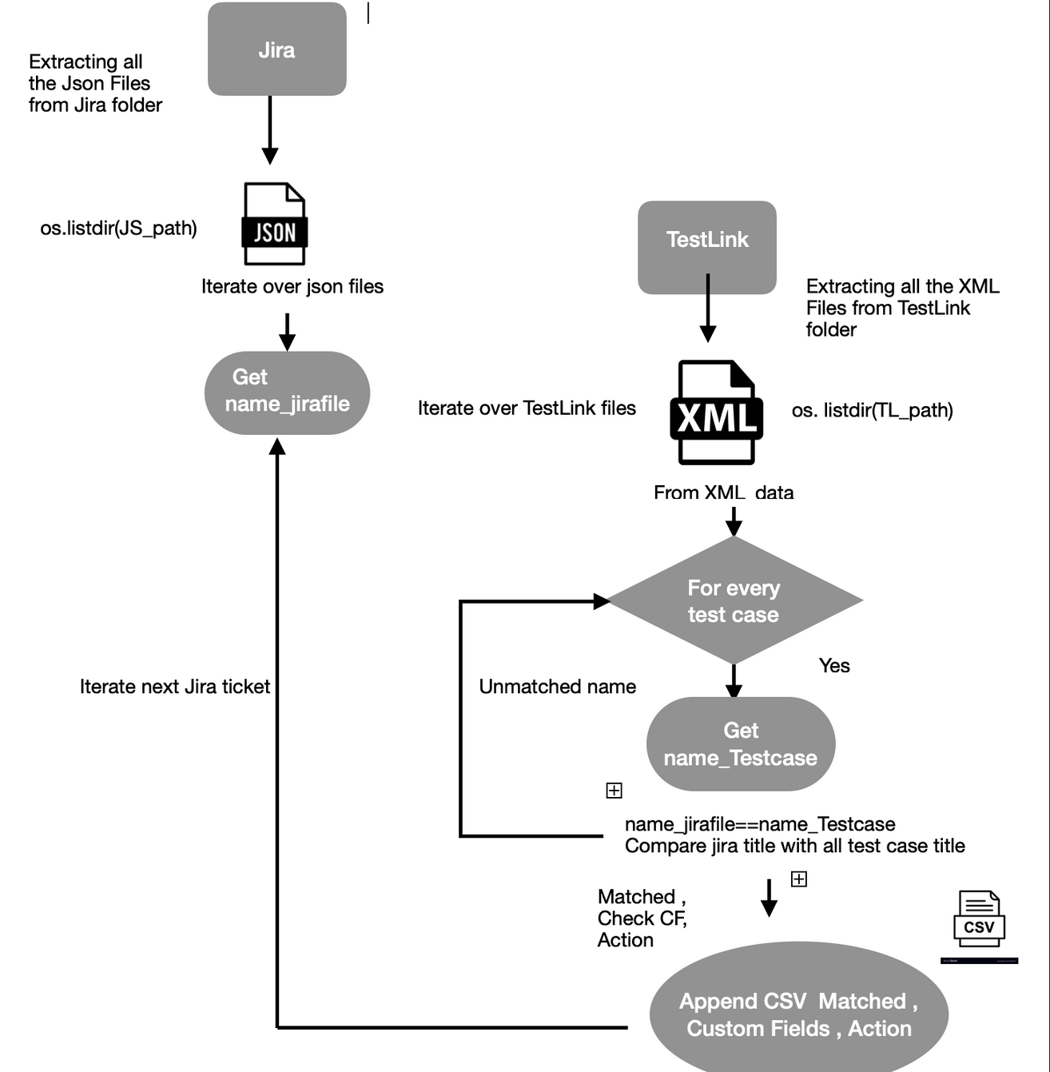
PROCESS OF
VALIDATION BETWEEN
JIRA - JSON FILE & TESTLINK - XML FILE
FOR TESTCASE
Copyright 2023, Ramco Systems Limited. Information subject to change. All rights acknowledged.

Slide 12
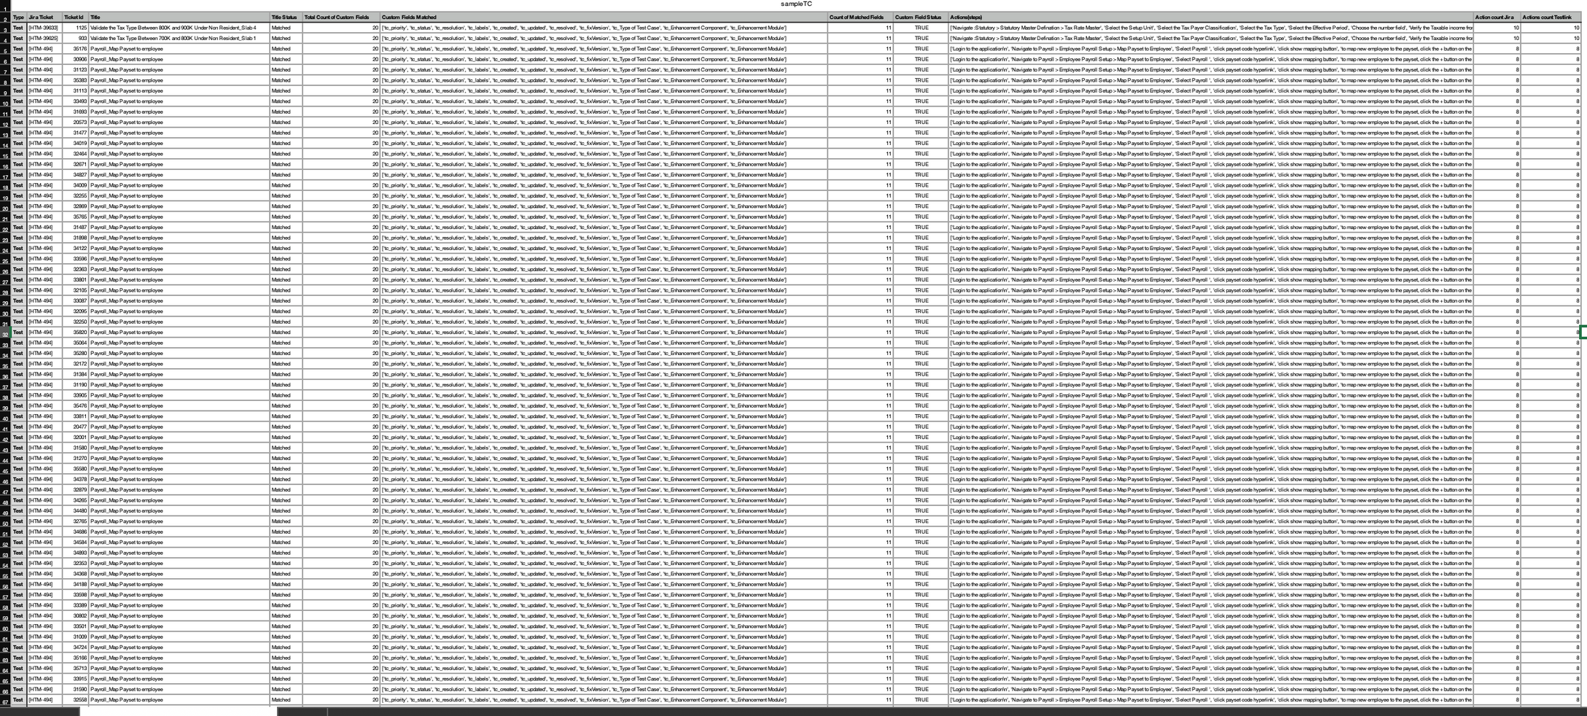
OUTCOME SAMPLE
MATCHED STATUS - TESTLINK ID , JIRA TICKET , TITLE , CUSTOM FIELDS , ACTION

Slide 13
THANK YOU
Copyright 2023, Ramco Systems Limited. Information subject to change. All rights acknowledged.

